Slide 1
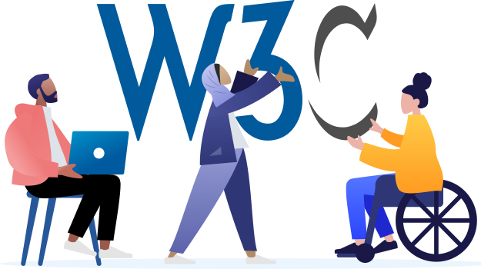
W3C’s eGovernment Interest Group Meeting
Internal Employee Use Only

Slide 2

Accessibility Principles and Promise
Today’s presentation uses the Web Content Accessibility Guidelines (WCAG) standards set by the World Wide Web Consortium (W3C).
WCAG is typically used for building web content; it is applicable when creating an electronically accessible asset.
Use the ‘Check Accessibility’ tool or use an assistive technology tool.
Other tools used to test for this PowerPoint’s accessibility:
  Accessibility Insights
For more questions about this PowerPoint’s accessibility, please email communications-staff@w3.org.

Slide 3

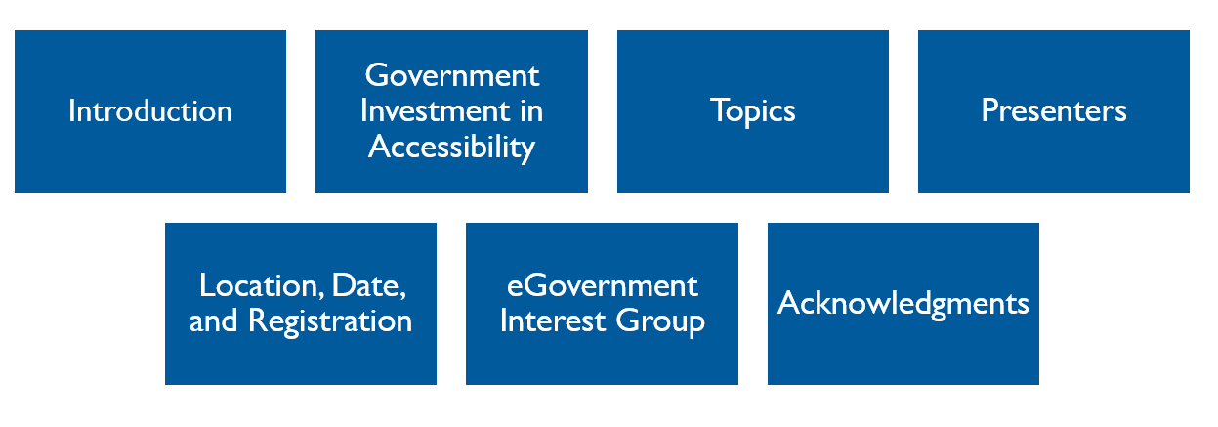
Agenda

Slide 4

Introduction: eGovernment Interest Group Welcomes Government IT and Policy Representatives
The eGovernment Interest Group will discuss:
  Goals
  Benefits
  Limitations
  Provide a forum to discuss with others the factors that may impact electronic government initiatives.

Slide 5
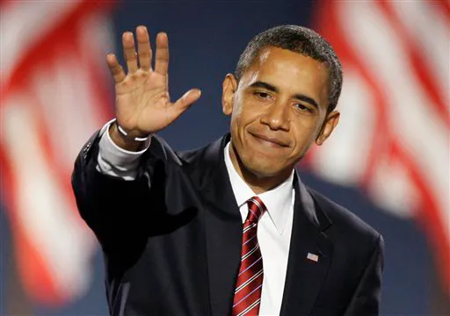
Government Investment in Assistive Technology
“We must build a world free of unnecessary barriers, stereotypes, and discrimination…policies must be developed, attitudes must be shaped, and buildings and organizations must be designed to ensure that everyone has a chance to get the education they need and live independently as full citizens in their communities.”
– Barack Obama, 11 April 2008
On December 11, 2007, Senator Barack Obama shared his equal opportunity plan for Americans with disabilities, including investing in assistive technologies to help overcome barriers.
The eGovernment Interest Group selected topics that can support Government Representatives with their task in creating inclusive policies.

Slide 6

Topics
The meeting will also include discussions on the draft use cases collected by the eGov group to help create a road map to solve the following:
  Transparency, openness, and inclusivity
  Motivating and engaging citizens
  Use of multi-channels
  Increasing productivity
  Reducing costs

Slide 7

Presenters
Our presenters are from the global government and the private sector. Here is a limited list of presenters below; the other presenters will be on the agenda:
Ellen Miller, co-founder and executive director of the Sunlight Foundation
John Sheridan, Head of e-Services and Strategy for The National Archives of the United Kingdom
Kevin Novak, Vice President, Integrated Web Strategy and Technology, The American Institute of Architects
Jose M. Alonso, W3C eGovernment Activity Lead and CTIC Fellow based in Spain
Steve Ressier, GovLoop
Beth Noveck, Office of Science and Technology Policy

Slide 8

Location, Date, and Registration
The eGovernment Stakeholder Meeting is a two-day event being hosted by the American Institute of Architects in Washington, DC.
  Date: 12-13 March 2009
  Time: 0900 to 1700EST (Networking event in the evening on March 12th)
  Location: American Institute of Architects, 1735 New York Ave. NW, Washington, DC
  Cost: Free
  Contact: Jose M. Alonso, W3C eGovernment Activity Lead and CTIC, for more information.
  Advanced registration is required due to limited space.
  An agenda for 12-13 March will be included, but meals are not. Please be prepared to bring a packed lunch or money for nearby restaurants.

Slide 9

About the eGovernment Interest Group
  Launched 3 June 2008
  Open to the public, free of charge, and does not require a W3C membership
  Build and strengthen the W3C Electronic Government initiative and improve interactions
  The group identifies and discusses various accessibility topics
  Task forces
  Group Chairs, Members, and W3C (employees) contacts

Slide 10

Acknowledgements
World Wide Web Consortium (W3C)
eGovernment Interest Group
Recite Me
TPGi
Accessibility Insights

